Slide 1
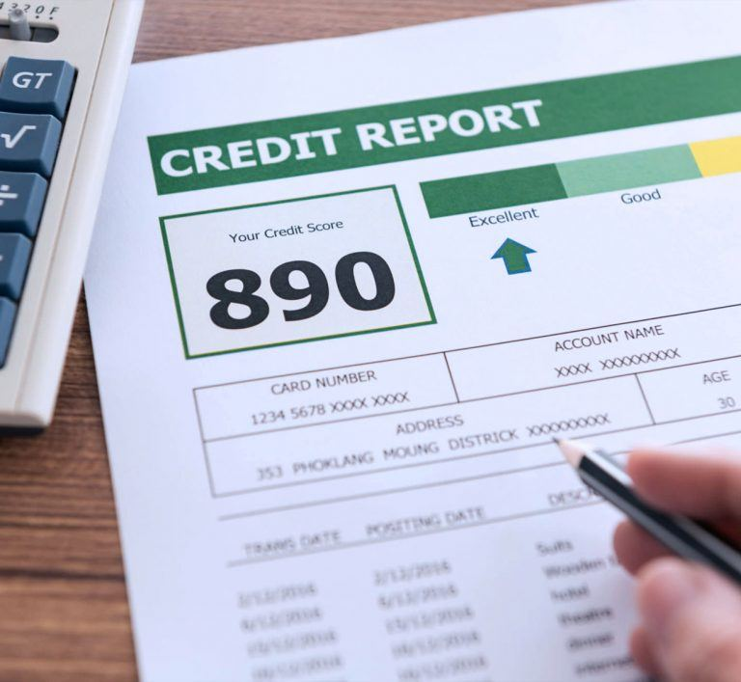
Oreoluwa Seweje
Sprint 1 Presentation | 2024-03-08
Notes:
Introduce yourself, and what you’re looking to present. Mention that there is a mini-game if anyone is interested. Some images have easter eggs for a movie. If the numbers get boring try to guess the movie before the end of the presentation. For my first and only trick I’ll try to guess where your mind went

Slide 2

s
Notes:
Pretty sure from the first image here is where your minds went. From the first image. Yes credit reports are usually required when trying to get a loan from a bank or from third-party lenders but [move to the next slide]

Slide 3


Where it’s needed
Loan Approval:
When an individual applies for any type of loan—be it a mortgage, personal loan, auto loan, or business loan—lenders check the applicant's credit history to assess their creditworthiness.
Apartment Rental:
Many landlords and property management companies check potential tenants' credit histories as part of the rental application process. They use this information to evaluate the risk of the tenant defaulting on rent payments.
Insurance Premiums:
Insurance companies may use credit history to determine insurance premiums for products such as auto or homeowners insurance.
Credit Card Application:
Credit card issuers review an applicant's credit history to decide whether to approve their application and to determine the terms of the credit offer, such as the credit limit and interest rate.
Notes:
Here are examples of other cases where credit reports are necessary. Mention back home.. Credit report for apartment rentals are not a thing. Usually have to pay the entire lease upfront or first six months. But what happens when one does not have a credit history? Typically you would need to intentionally engage in financial activities that are reported to credit bureaus, such as opening a secured credit card, becoming an authorized user on someone else's credit card, or using a credit-builder loan.

Slide 4


Young Age or New to Credit:
Individuals who are young or have recently become eligible to apply for credit may not have had the opportunity to build a credit history. This includes young adults, students, or recent immigrants who haven't used any credit products in their name.
Cash-based Lifestyle:
Some people prefer to live a cash-based lifestyle, paying for everything with cash or debit cards and avoiding borrowing or credit products altogether. While this can be a financially sound way to live, it does not contribute to building a credit history.
Lack of Borrowing History:
To have a credit history, an individual must have had some form of credit, such as a loan or credit card, reported to the credit bureaus. If someone has never borrowed money or had a credit account, they won't have a credit history
Recent Immigration:
Immigrants may have had a substantial credit history in their home country, but when they move to a new country, they often have to start from scratch. Credit histories do not transfer across borders
Inactive Accounts:
If an individual has not used credit in a long time, their accounts may become "inactive" from the perspective of the credit bureaus. They need to be active, with regular transactions reported to the credit bureaus, to contribute to a credit history.
Accounts Not Reported:
Some lenders or account types might not report activity to all, or any, of the major credit bureaus. For example, smaller banks, credit unions, or alternative lending services may not always report payments. Additionally, regular payments like rent and utilities are not automatically reported to credit bureaus (though there are services that can help get these payments included in credit reports).
Notes:
Here are reasons not to have a credit history. Focus more on immigration and cash-based lifestyle

Slide 5


Notes:
Hence the problem. We need either loan approval, make a credit card application or try to get a rental property… That is not the time to start engaging in credit-friendly financial activities. We need an alternative. Following the trend we are going to throw a machine learning model at the problem.

Slide 6

Create a Machine-learning model that takes financial information to make a prediction
Link: Home Credit - Credit Risk Model Stability | Kaggle
Notes:
Create a machine-learning model that predicts if a user is likely to default their on their loan request. Some solutions exist currently but they have a stability issue.

Slide 7

What do we mean by stable?
Credit scoring models typically have a lifecycle of a year or more, and their consistent performance over time is key. The solution must be stable over weeks on the future sample (test set).
Notes:
Solutions exist that make predictions but don’t generalize well. Can predict well for 6 months but not 8 months, or 8 months but not a shorter duration. We or I plan to account for that. Clarify not doing a time series model. Doing a prediction but how we handle the features have information about how far we want to predict which is what makes ours adaptable.

Slide 8

Dataset Overview
1,000,000 + rows of data and 220 columns
Sparse Data: Less than <10% of full information
High Imbalance: 97% no default
Link: Home Credit - Credit Risk Model Stability | Kaggle

Slide 9
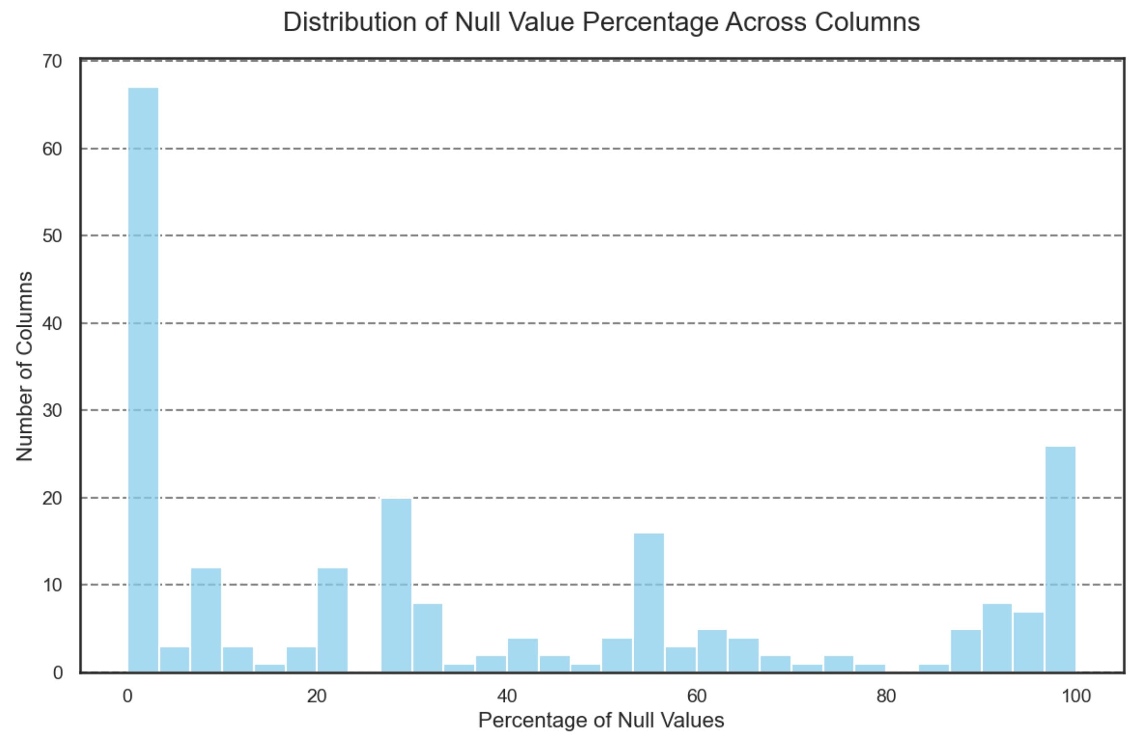
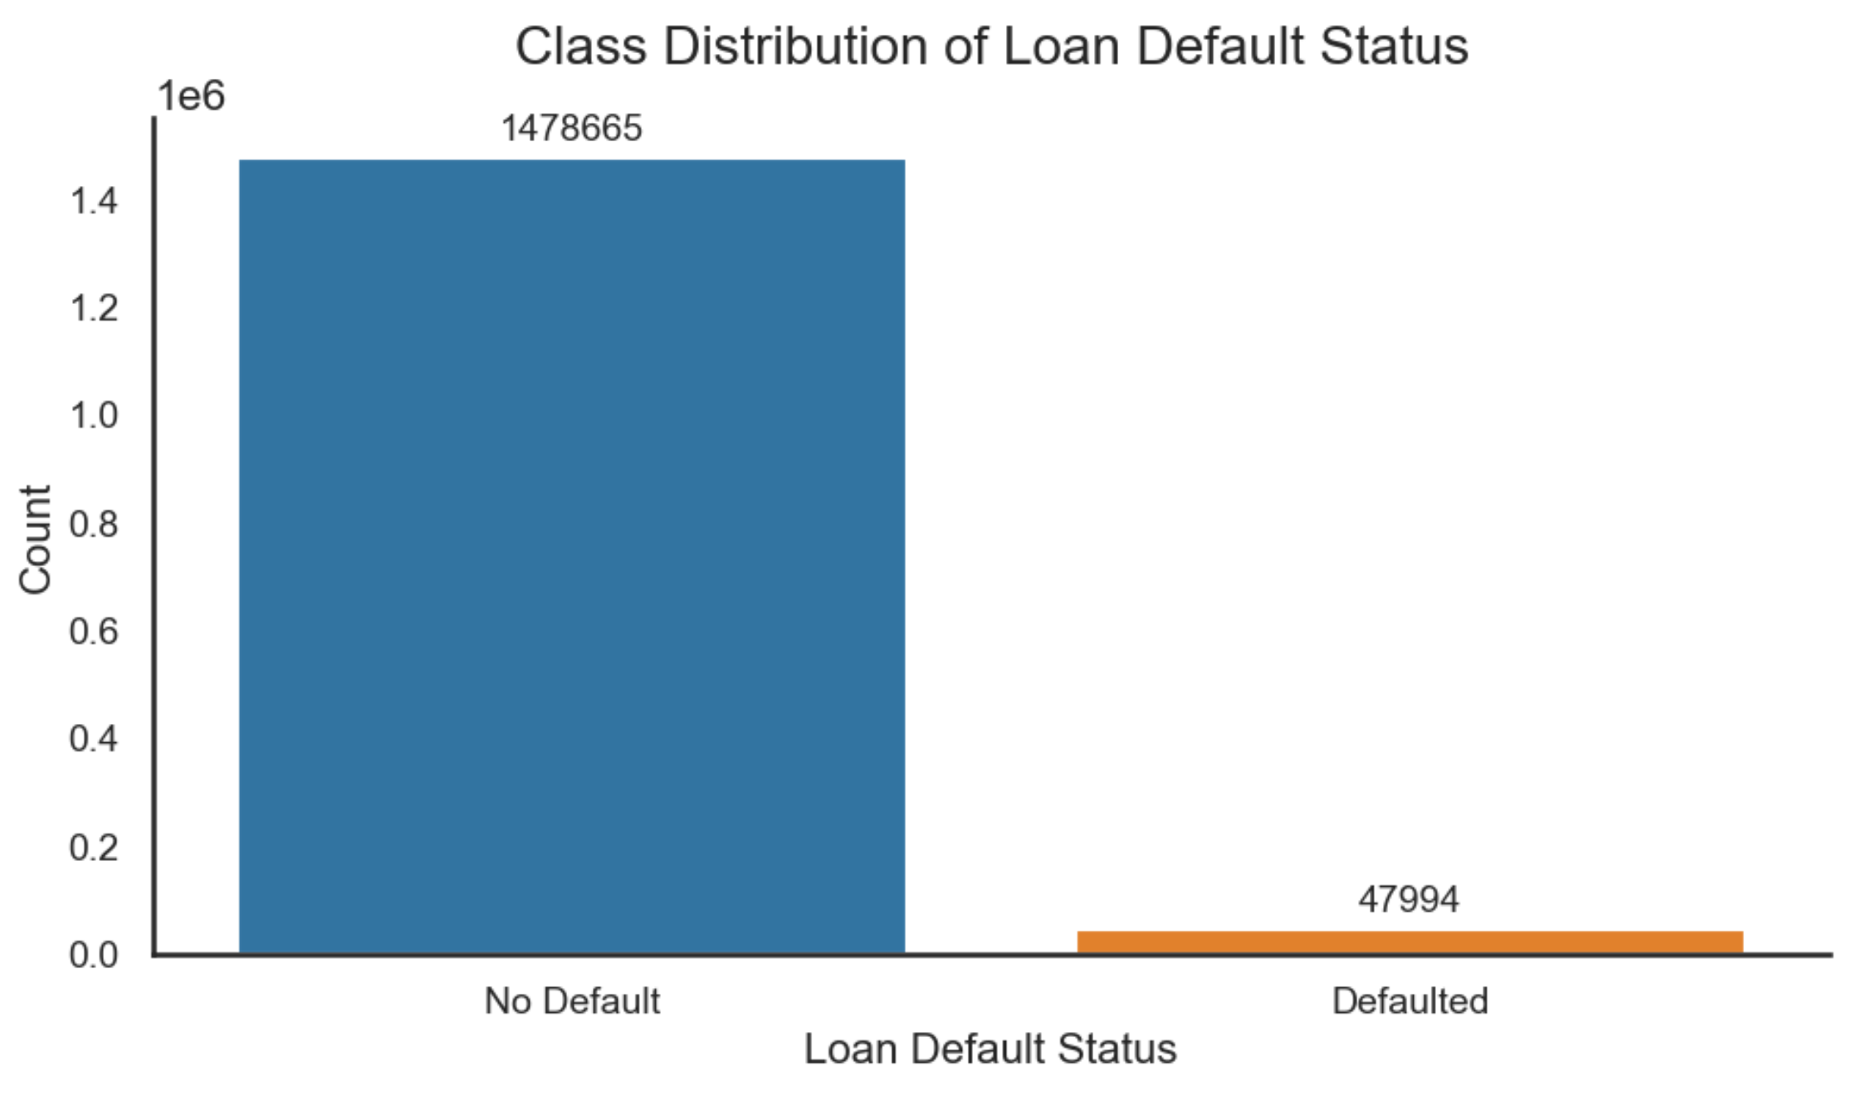
Notes:
Talk about the distribution and because of the level of scarcity, we have to take null values as features as opposed to trying to remove them. Also during the modelling we will attempt to account for class imbalance. There are techniques for that

Slide 10

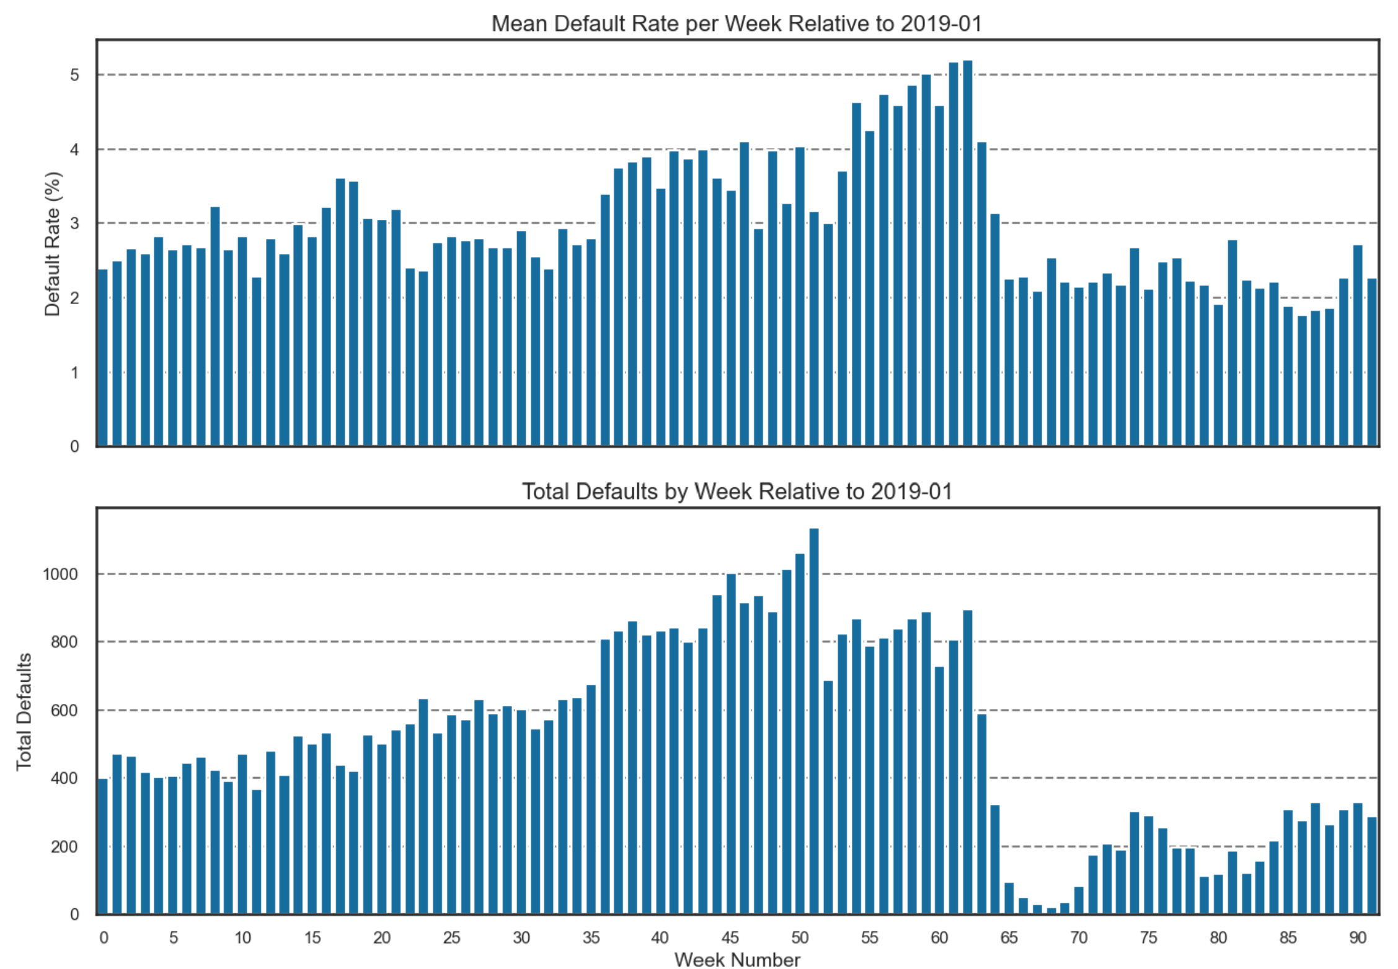
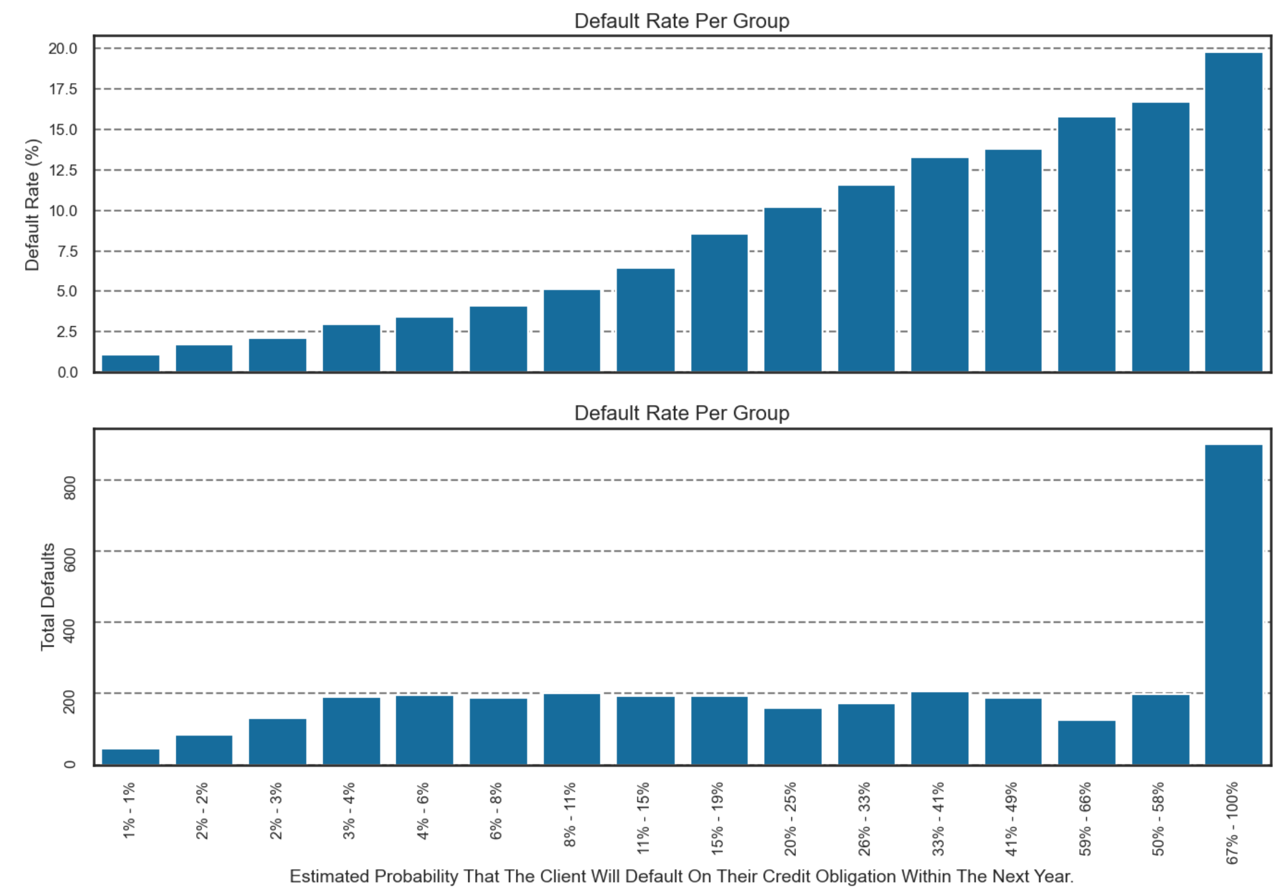
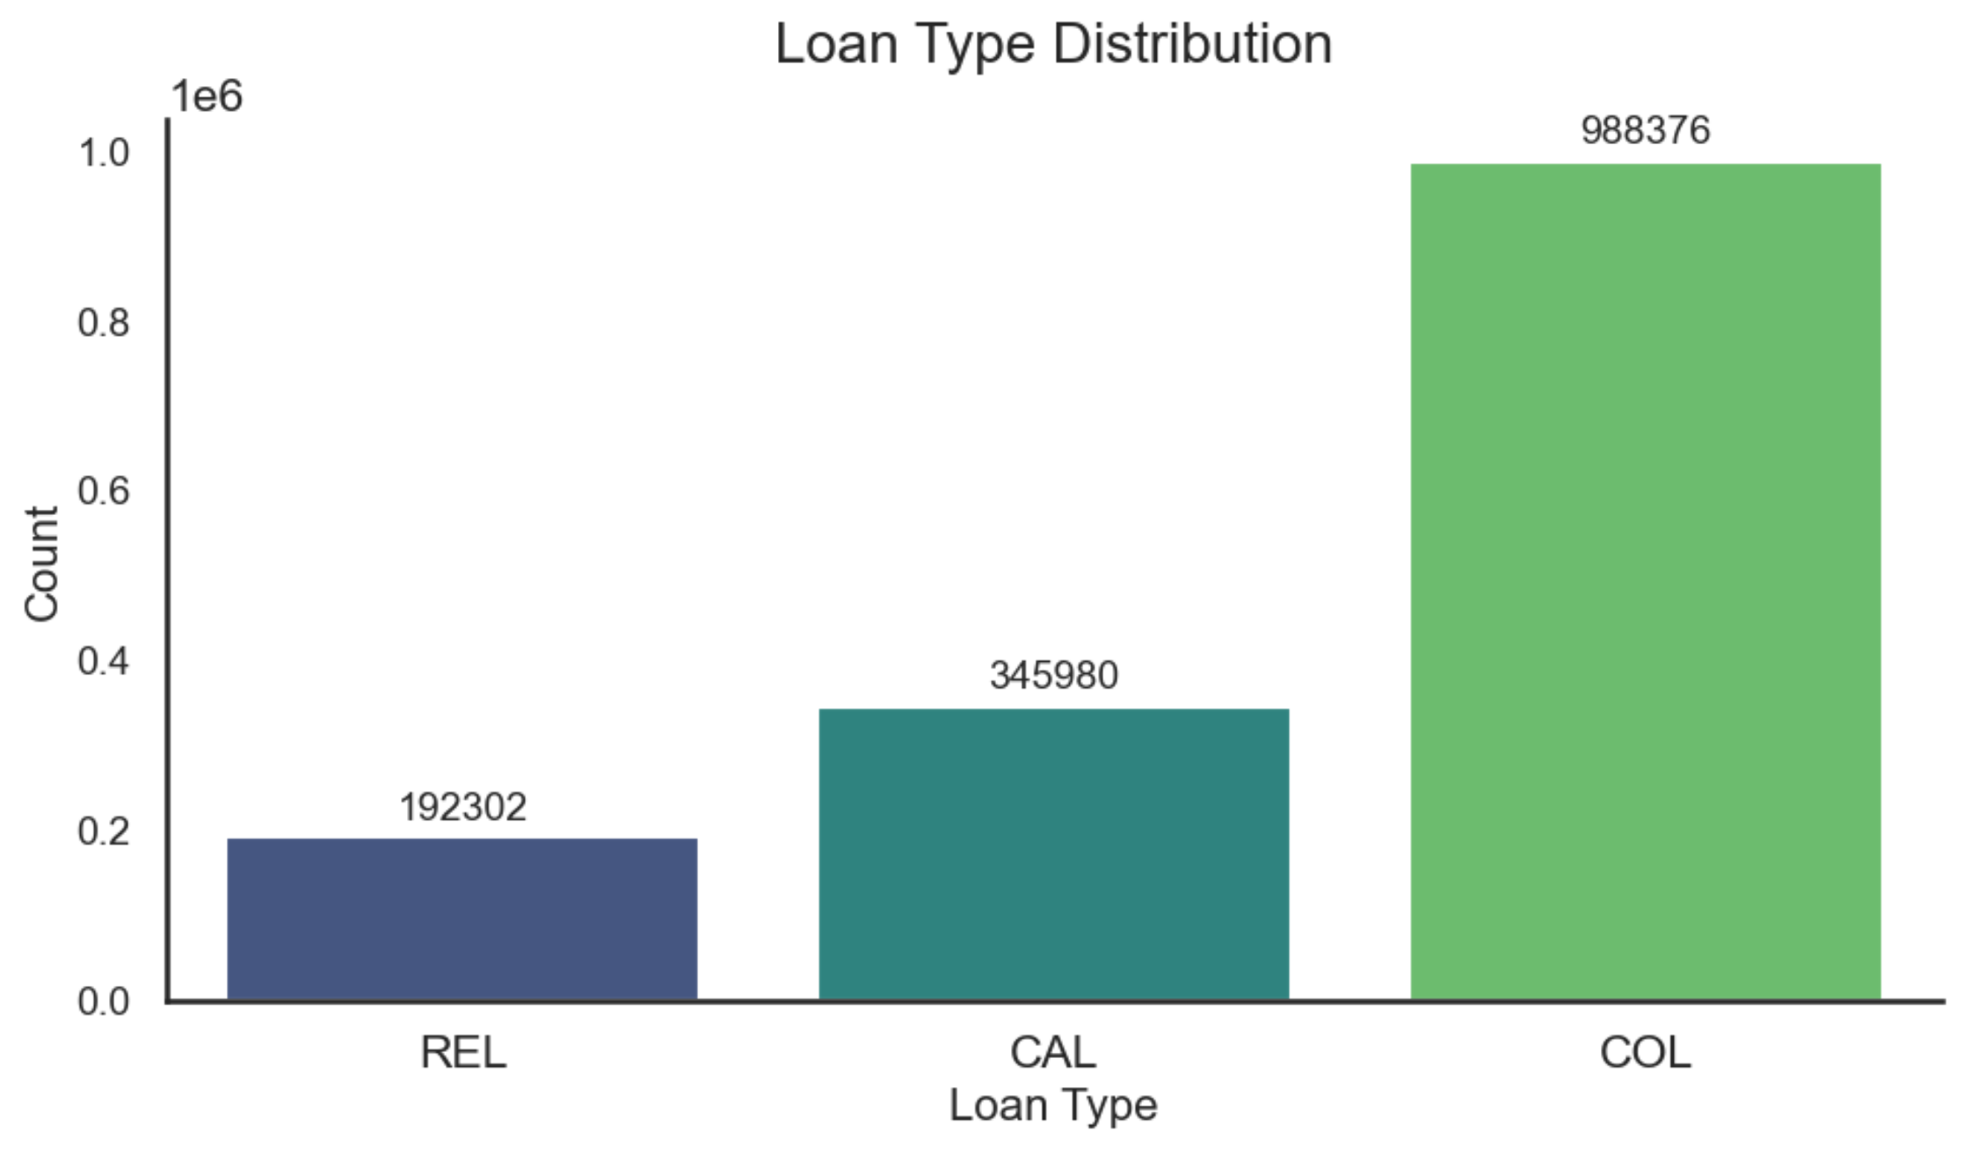
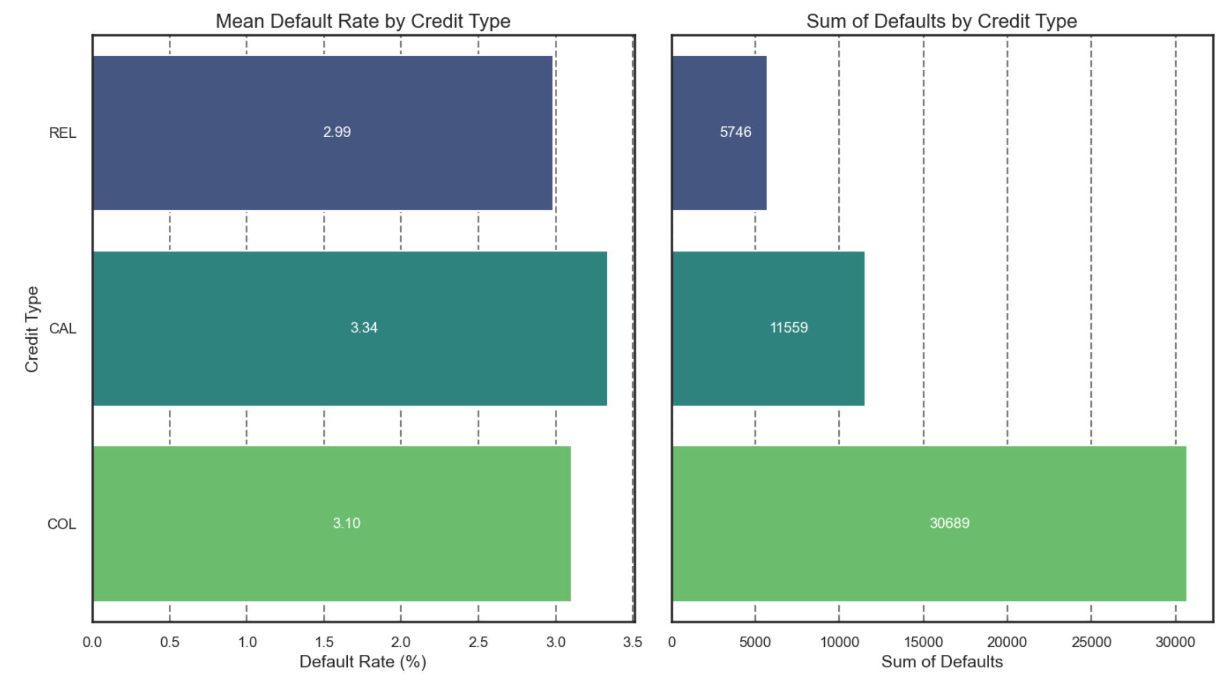
Notes:
At final stuff [Default Rate Per Group]: Mention that the jupyter notebook includes an analysis on the type of client that is most likely to fail. Further explored the 67 – 100% region to find the most likely people to default

Slide 11

Where do we go from here?

Slide 12

Next Steps:
Incorporate Methodologies from Recommendation Systems:
To enrich the semantic representation of our dataset, we will adopt strategies inspired by advanced recommendation systems. Specifically, we propose to tokenize each row of our tabular data, thereby encoding richer semantic information within our model’s input data.
Progressive Introduction of Enhanced Data Stages:
The dataset previously outlined represents only the initial phase (Stage 0) of our data preparation process. As part of our model development strategy, we plan to methodically introduce subsequent stages—namely, Stages 1 and 2. These advanced stages will be integrated incrementally during the model training phase, following the establishment of a baseline performance using Stage 0 data alone.
Weight Adapted Loss Function:
This approach will modify the evaluation metric to become a dynamic weighted score, enabling it to adjust responsively to specific periods that present higher error rates. Consequently, this adaptive scoring will inform the optimization of training weights in real-time during the backpropagation process, facilitating improved model robustness and predictive performance.
Notes:
Here are examples of other cases where credit reports are necessary. Mention back home.. Credit report for apartment rentals are not a thing. Usually have to pay the entire lease upfront or first six months. But what happens when one does not have a credit history? Typically you would need to intentionally engage in financial activities that are reported to credit bureaus, such as opening a secured credit card, becoming an authorized user on someone else's credit card, or using a credit-builder loan.

Slide 13



Slide 14

THE END ..

